Slide 1
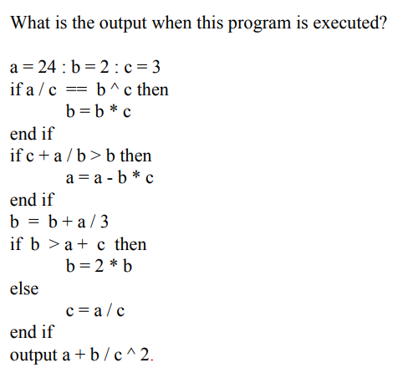
1
Warmup
2
Afterwards: Write down what you know about coding
Notes:
Answer:
8

Slide 2

Day 1:
Python Intro

Slide 3
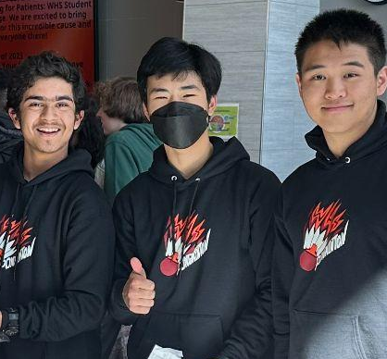
Hello!
I am Joongeun (Joon) Choi
Grade 11
Live in US
Hobby: Badminton, annoying my sister
Coding Experience: ACSL, Arduino Board
Notes:
Students stand up one at a time and introduce themselves

Slide 4
ROADMAP
Variables
Conditionals
Math operations
Loops
Lists
1
3
2
4
Functions/methods
Input
Make your own calculator app!
Dictionaries
Algorithms practice
Notes:
Today we’ll learn about -___- it’s ok if you don’t know what this is for now but it’s basically
The last day we’ll be practising coding problems in groups so. Just learning how to code is just the beginning; you need to practice coding problems and also make lots of mistakes and fix those mistakes (which is called debugging) to improve little by little.

Slide 5
1
Application

Slide 6



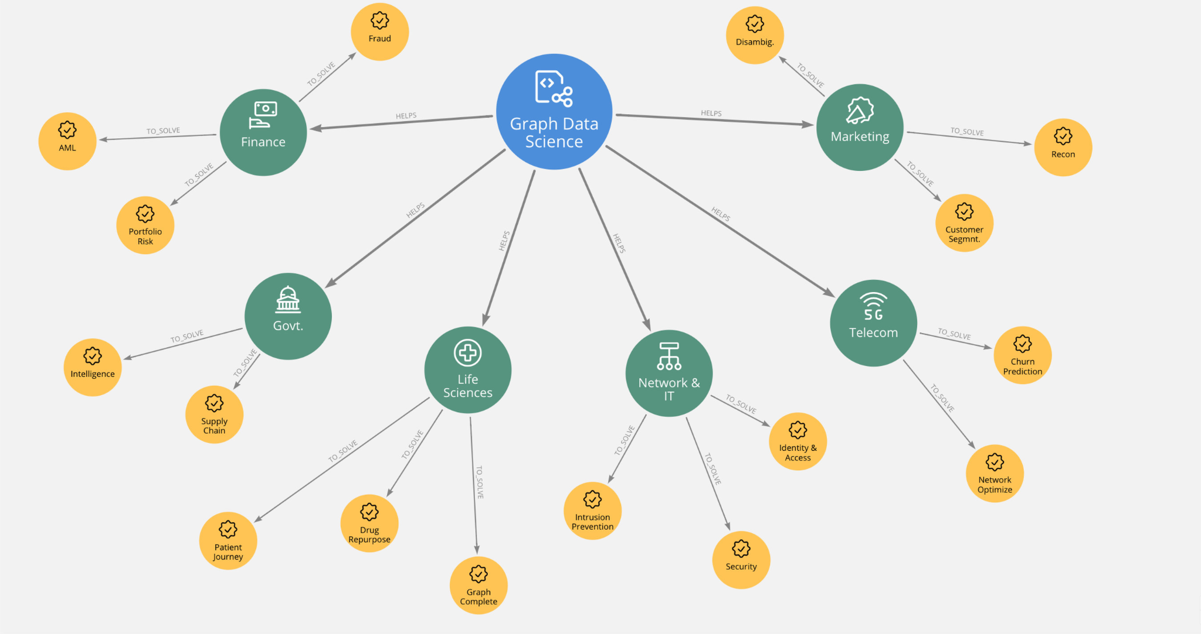

Web/App/Game Development
AI
Data Science
Automation
Notes:
Coding is used for a variety of applications
You can use coding to solve problems

Slide 7
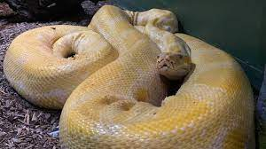
2
How it works

Slide 8

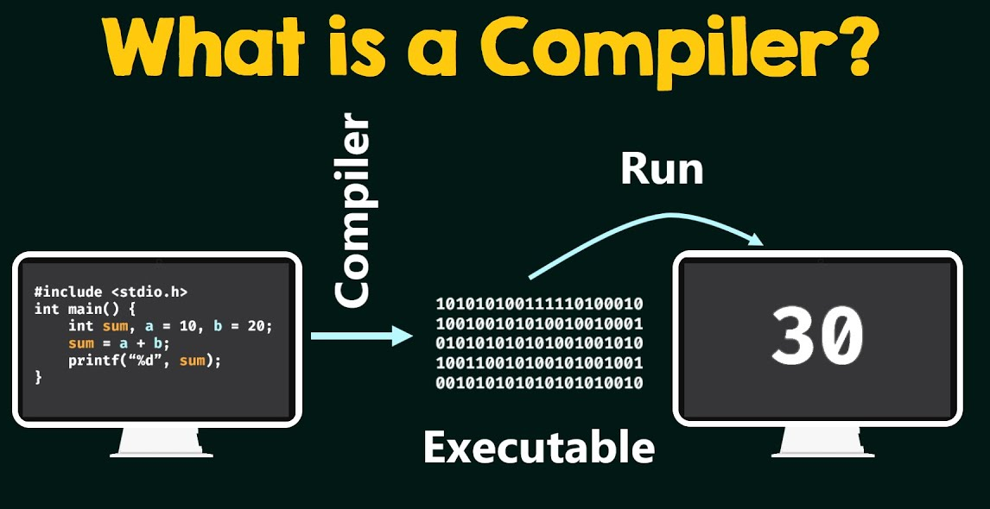
Text to Binary
Computers understand binary (0s, 1s)
You must give exact instructions!
Notes:
Python code is high level - it is something humans can read and write
The compiler converts the code we write into binary which the computer interprets and runs
We can’t just tell the computer to do a task, we must give specific instructions on how to do it

Slide 9
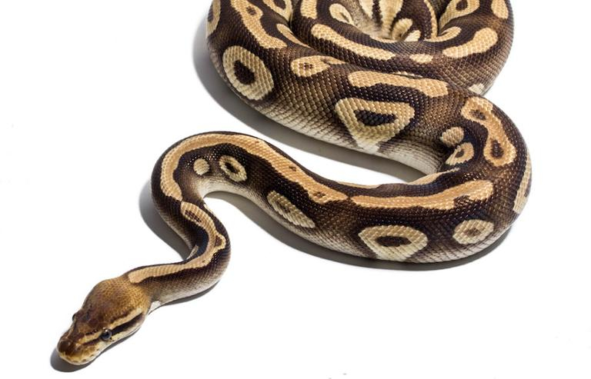
3
Setup, Variables, Strings

Slide 10

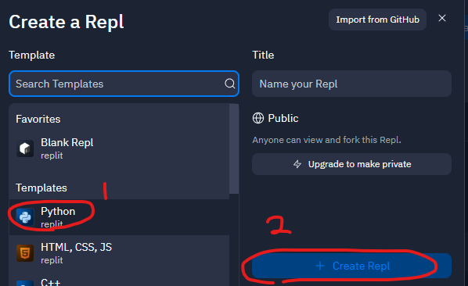
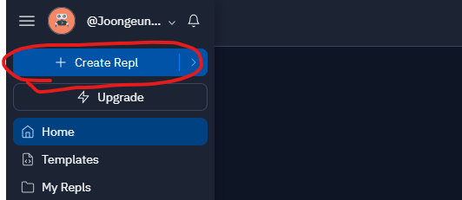
Create a file
Go to: replit.com and make a new account
Open python file
Notes:
https://www.online-ide.com/

Slide 11
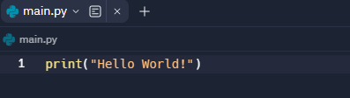
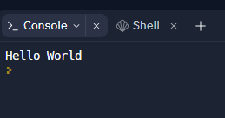
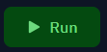
Print
→
→
You need quotation marks around text - otherwise it will be interpreted as a variable

Slide 12
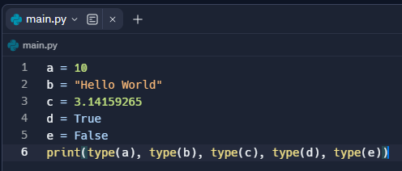
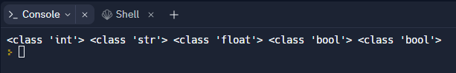
Variables
Note: don’t use special symbols for var. names!
What is int, str, float, bool??

Slide 13
Data Types
int: integer (-2147483648 through 2147483647)
float: decimal
str (string): text
bool (boolean): True/False
Other types: tuples, list, dict, set, etc.

Slide 14
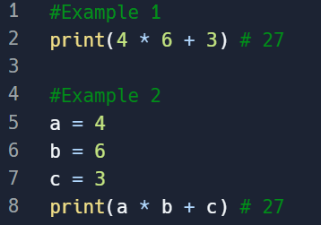
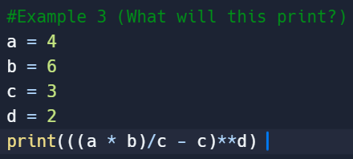
Numerical Operations
Use comments!
What will this print?
type: float
(from ‘/’)
type: int

Slide 15
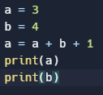
Variable Reassignment
Notes:
You can do this as many times as you want

Slide 16
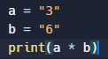
String Operations/Debugging

Slide 17
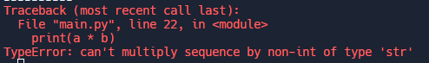
Error Message:

Slide 18
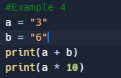
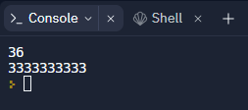
Adding/Multiplying Strings

Slide 19
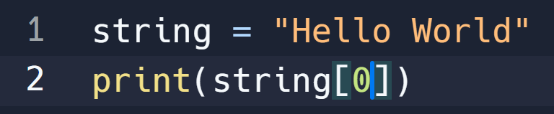

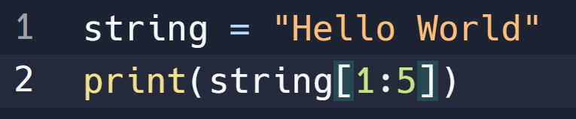
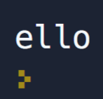
String Indexing
Access the ith character of string with "[i]"
Indices start from 0
"[i:n+1]" will get the ith-nth characters
(From 1, up to but not including 5)

Slide 20
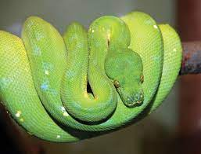
4
Conditionals

Slide 21
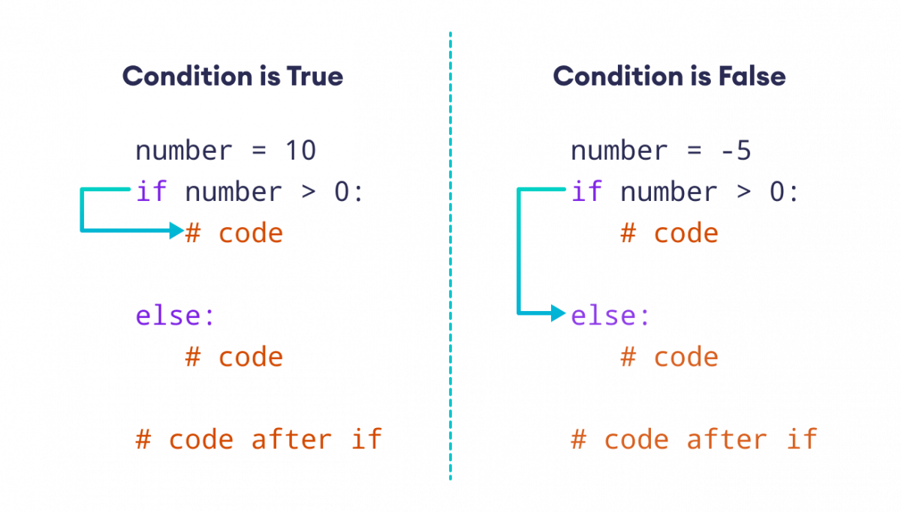
You can use “elif” to specify another condition (you don’t always need to use the “else”)

Slide 22
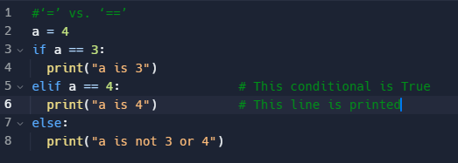
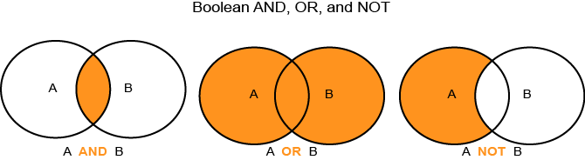
‘=’ vs. ‘==’:
and, or, not, != (boolean operators):

Slide 23
Let’s Practice!
https://codingbat.com/python/String-1
Try coding the warm up problem

